Slide 1





Extraction, transformation, loading and visualization of combined Twitter and Spotify data in a scalable architecture
Thesis of the Master’s degree in Business Intelligence and Big Data in Cyber-Secure Environments
July 2022
Adrián Riesco Valbuena
Tutor: Álvar Arnaiz González

Slide 2






Table of contents
Introduction
Objectives
Techniques and tools
Relevant aspects
Conclusion and future work lines

Slide 3
INTRODUCTION

Slide 4




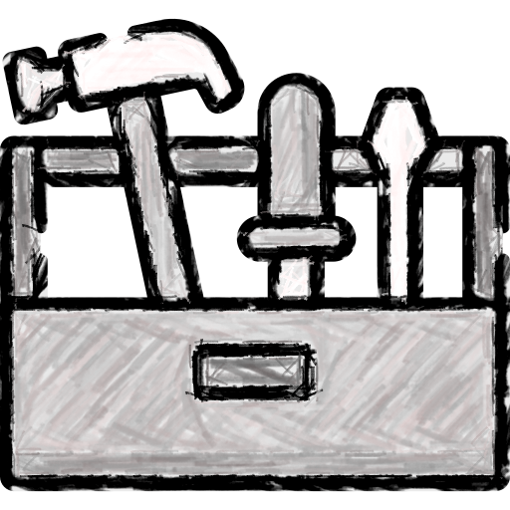
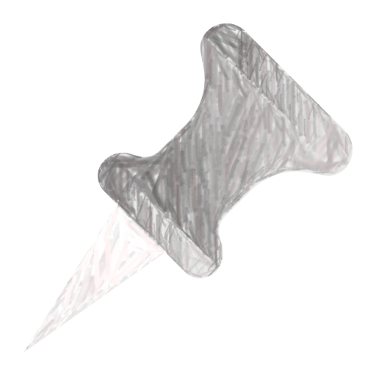


Introduction
Objective: Extraction, Transformation and Loading process to capture and visualize data from Twitter and Spotify APIs.
Using: Software tools from the Big Data domain and with a life cycle driven by agile methodologies.
Highlights:
Service containerization.
Data flow orchestration.
ETL processing (data search, cleaning, merging and loading).
Data storage.
End user visualizations.

Slide 5
OBJECTIVES

Slide 6


Main objectives
Ability to obtain data in real time.
Combination of at least two different data sources.
Potential to scale in both technology and data volume.
Involvement of various technologies in the Big Data field.
Use of open source tools
Design and implementation of two visualizations for the end user.

Slide 7
Functional requirements
FR1
Data must be obtained from the Twitter hashtag #NowPlaying every 30 minutes.
There must be at least two different visualizations and one of them must provide the ability to view all of the stored data.
At least one of the visualizations must show last songs name, artist and audio features.
At least one of the visualizations must have a link to the source tweet.
At least one of the visualizations must have the ability to compare different metrics.
At least one of the visualizations must combine two different types of visualizations.
Both visualizations must provide sorting capabilities.
Both visualizations must be responsive to different screen sizes.
FR2
FR3
FR4
FR5
FR6
FR7
FR8

Slide 8
Technical requirements
TR1
The development must have the ability to be deployed in different environments with minimum effort.
The data flow must be automated, with the entire process orchestrated by a single tool.
The execution of the ETL process must be done with a tool that can scale and run in distributed environments.
The data warehouse must have the ability to escalate in terms of a Big Data problem.
The web application must be designed with widely recognized tools.
All the tools used must be open source.
TR2
TR3
TR4
TR5
TR6

Slide 9
Techniques and tools

Slide 10
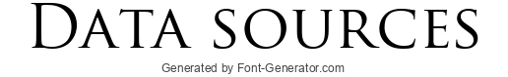

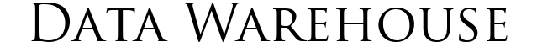
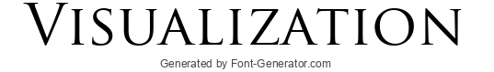







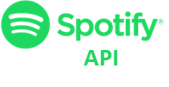



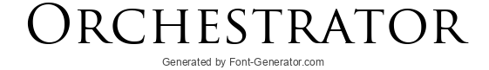
Techniques and tools
º
API
º

Slide 11
RELEVANT ASPECTS

Slide 12










Project plan
Agile methodology with sprints of two weeks and POV and backlog refinement meetings.
Stored in GitHub.
Sprint == Milestone.
Tasks == Issues.
Project start
Beginning of development
April break
Fully functional product
Project delivery

Slide 13



Data Twitter
Endpoint: Recent search
id. Tweet id (integer), useful uniquely identify the tweet.
text. Tweet text, useful to identify the song played.
entities. Useful to clean the text and remove hashtasg, cashtags, mentions and urls.
created_at. Tweet creation date.

Slide 14



Data Spotify
Endpoint: Search for Item
Endpoint: Get Tracks’ Audio Features
id.
name.
popularity.
artists’ id.
artists’ name.
id.
danceability.
energy.
key.
loudness.
mode.
speechiness.
acousticness.
instrumentalness.
liveness.
valence.
tempo.
duration_ms.
time_signature.

Slide 15
Cleaned data
id_tweet bigint
text text
created_at timestamp
url_tweet text
id_track text
name text
popularity int
artists_id text
artists_name text
danceability float
energy float
key int
loudness float
mode float
speechiness float
Acousticness float
Instrumentalness float
liveness float
valence float
tempo float
duration_ms int
time_signatura float

Slide 16


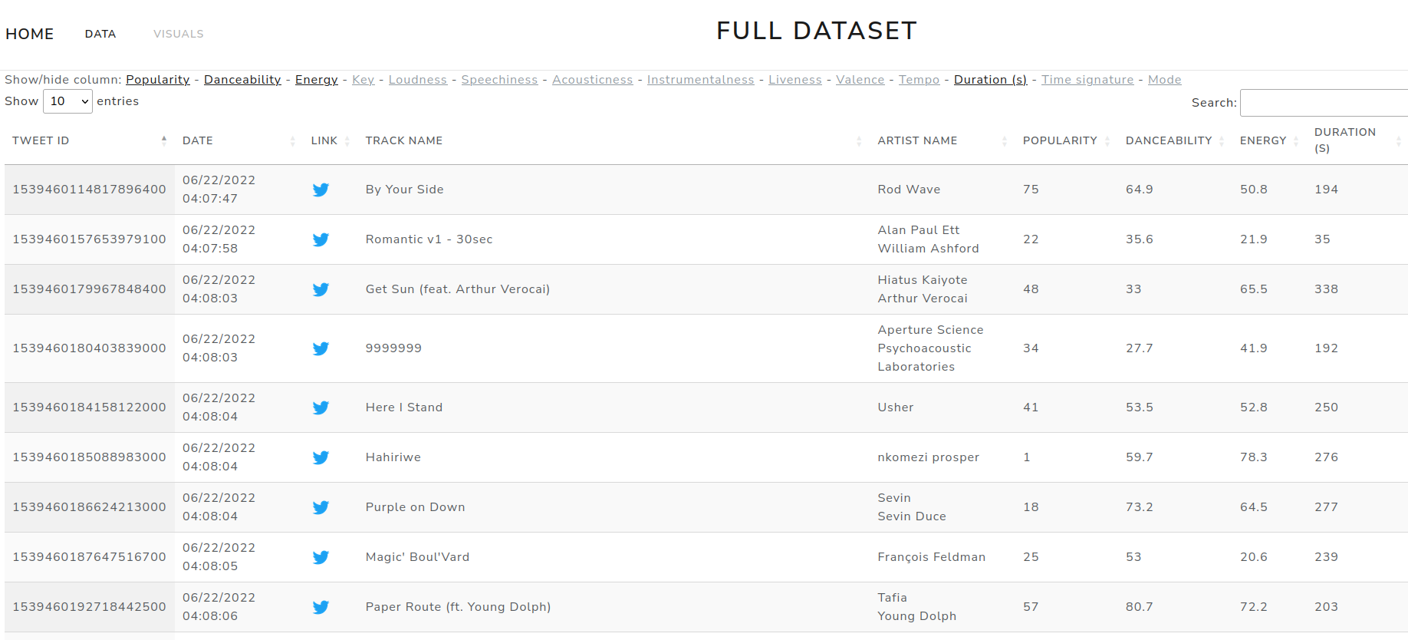

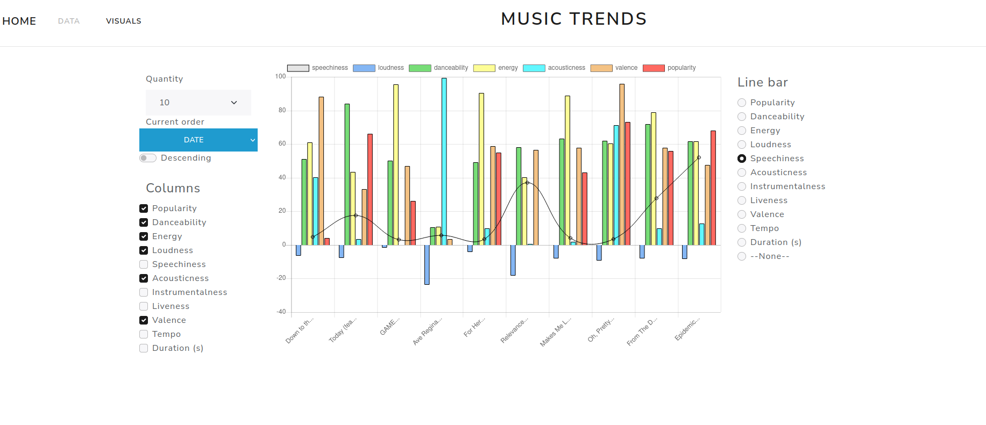






Data flow
º
API
#NowPlaying
API
Track search
Cleaned data
Stored data
Track data
º

Slide 17
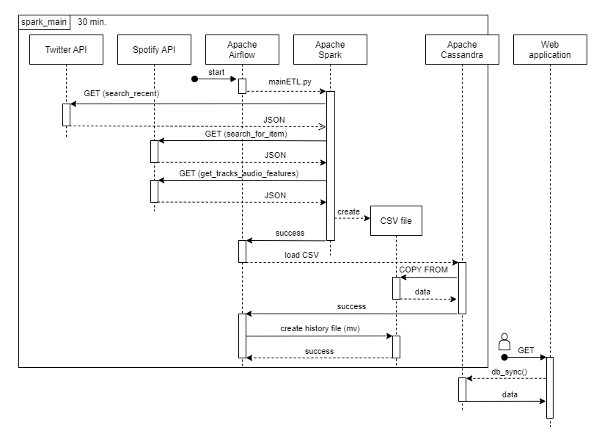
Data flow

Slide 18







Implementation highlights and challenges
Developer keys. Twitter and Spotify APIs required developer keys.
APIs’ rate limits. Maximum of 500.000 tweets per month.
Airflow operators. There is no specific operator for Apache Cassandra.
Airflow and Spark connection. Environmental variable to set connection.
Database schema configuration at launch. Additional container to create schema.
Data representation. Use of Datatables and Chart.js.
Mismatched tracks. Several languages and only the first result collected from Spotify.

Slide 19
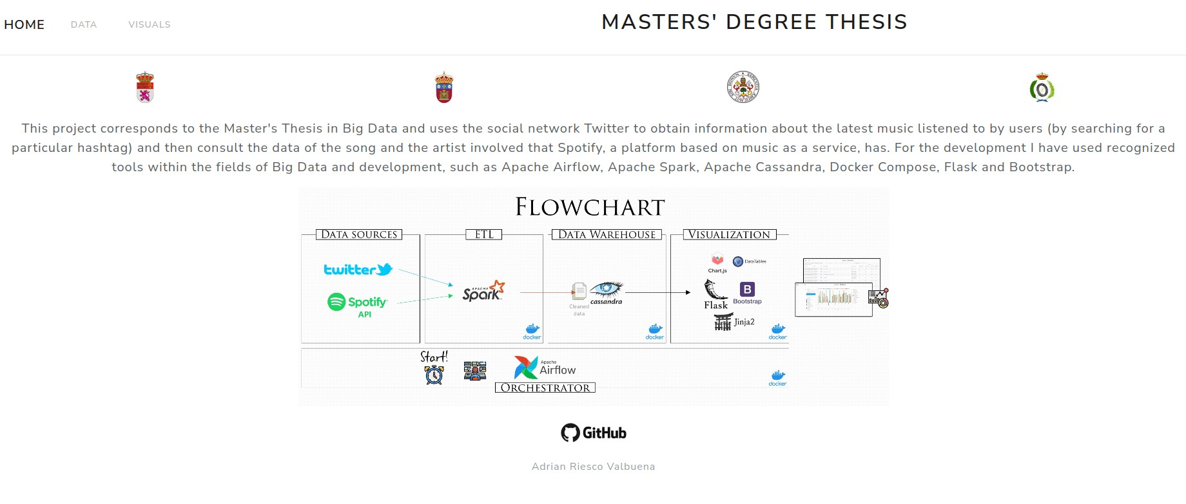
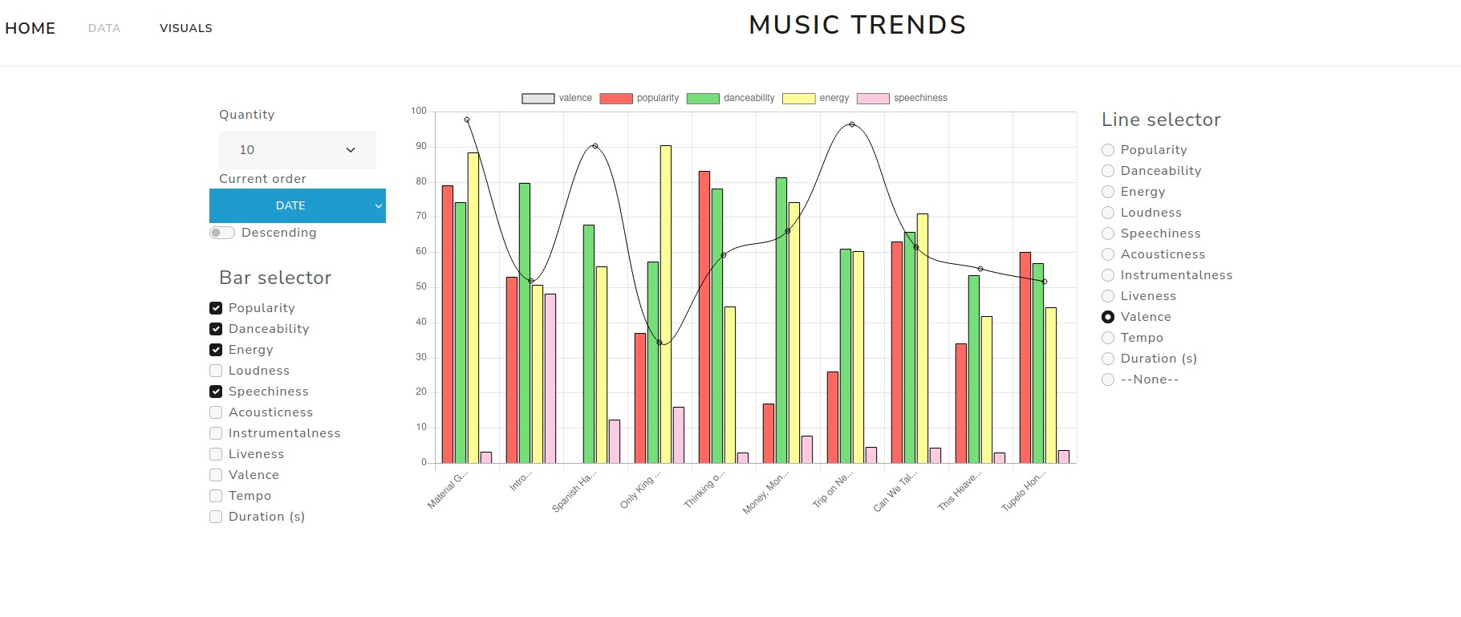
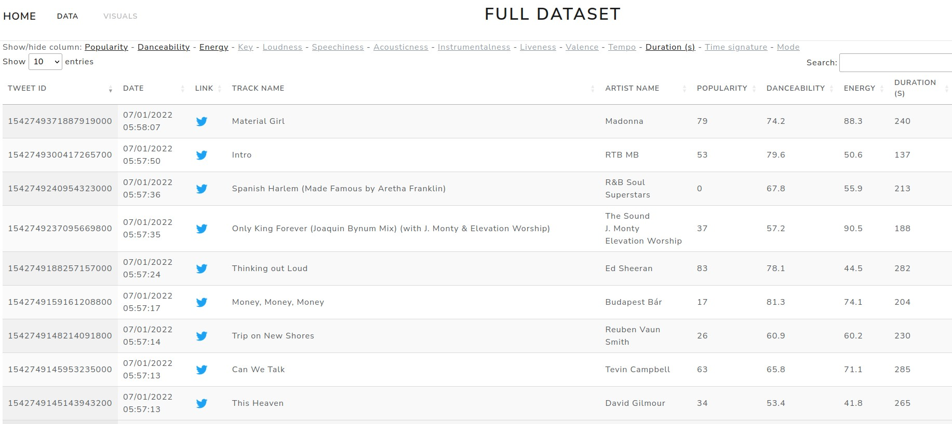
User interface

Slide 20
CONCLUSION AND FUTURE WORK LINES

Slide 21







Conclusion and future work lines
Final result is considered a success
Future work lines:
Improve the percentage of correctly identified tracks.
Ensure that we capture as much data as possible.
Add visualizations in the front-end layer.
Upload from history functionality.
Replace Docker Compose with a more suitable tool.
Refactor the code.
Partial or total migration to the cloud.

Slide 22

Questions?

Slide 23
Thank you for your time!
Adrián Riesco Valbuena

